Slide 1
Chapter 4: Programming Concept With C
Presented By Milan Bista Sir

Slide 2
Review of Grade XI
Defination of C, Importance of C, Variable,Constant,data types,format specifier,keywords,headerfile,library function,etc
(1) Control Structure
A) Sequence B) Branching Statements and C) Looping Statements
A) Sequence:
B) Branching: → (i) condtional and (2) unconditional
i) Condtional: → if(), if elseif(), and nested elseif()
ii) Unconditional: → switch() case:, break,continue,goto etc.
C) Loop/iteration:
i) while(), do while(), for(), nested loop
Array
A) 1-Dimensional B) 2-Dimensional or Multi-Dimensional
(3) String : strlen(),strlwr(),strupr(),strcpy(),strcat(),strrev(),strcmp() etc.

Slide 3
Grade XII
(4) Function:-> User define function vs Library Function,
categories of User Define Function
(5) Structure and Union:
(6) Pointer:
(7) File Handling:

Slide 4
Function:
Functions are the building block of statements, which takes some data, manipulate them and can return a value. Bug free function can be used repeatedly from other part of the program. There are two types of functions:
1. Library Functions (built in or ready made): C has the facilities to provide library function for performing some operation. These functions are present in the c library and they are predefined. for eg.
a. scanf( );
b. printf( );
c. getchar( );
d. putchar( );

Slide 5
2. User Defined functions (Defined by user according to need): user can creates their own function for performing this type of a function are called user define function.
Syntax of user defined functions
# include<stdio.h>
# include<conio.h>
void main( )
{
…………..
……………→ calling functionm
}
function ( ). // user defined function
{
body of the function
}

Slide 6
Advantages of Function:
1. Big programs can be divided into smaller module using functions.
2. Program development will be faster.
3. Program debugging will be easier and faster.
4. Use of functions reduce program complexity.
5. Program length can be reduced through code reusability.
6. Use of functions enhance program readability.
7. Several developer can work on a single project.
8. Functions are used to create own header file i.e math.h
9. Functions can be independently tested.

Slide 7
Arguments and Parameters
Arguments: The variable used in the function reference called 'arguments’. These are written within the parenthesis followed by the function name. They are also called actual parameters which they are accepted in the main program.
Parameters: The variables used in the function definition are called 'parameters.’ They receive value from the calling function. Parameters must be written within the parenthesis followed by the name of function in the function prototype.

Slide 8
Elements of function
Function prototyping (function declaration)
Function calling
Function definition
Return Statement

Slide 9
a) Function prototype:
Function prototype is the actual name of the function. The function name and the parameter list together constitute the function signature. The function prototype is written at the beginning of a program. The function prototype provides the following information to the compiler.
  The type of data type which is going to return
  The function name
  The types of argument and number of argument
Syntax: return_data type function_name( argument 1, argument 2, argument 3,….)
Example:
int area (int, int)
In this example, area is the function name which consists int type two arguments and return
type is integer.
Where,
data_type | the type of data type such as int, float etc
function_name | name of the function
argument | the list of variable

Slide 10
b) Function Definition:
Before using the function, it must be defined. Function definition consists of the type of data type which is going to return, functions name and the data type and numbers of arguments.
Syntax: data_type function_name( argument 1, argument 2, argument 3,….) where
Example:
int area (int l, int b)
{ int a;
a = l*b
return (a)
}
In the above example, area is the name of function, l and b are the argument that are used to
receive the value sent by calling statement and return value after processing.
data_type | the type of data type such as int, float etc.
function_name | name of the function
argument | the list of variable

Slide 11
c) Calling the function:
The functions are defined for calling. It can be called anytime from anywhere in the program. A call function is written with the function name exactly defined. It is followed by the list of arguments that are declared during the definition. Syntax: variable = function_name (argument 1, argument 2, argument 3,……..)
Where,
Example:
x = area (l, b); sum (a, b);
variable | The name that variable that store returned value
function_name | name of the function
argument | the list of variable

Slide 12
d) Return statement:
After manipulation data within the function, the final value should be returned. The final value is returned by using the return statement to the calling module. The return keyword followed variable or expression that going to return. The return statement returns single value at a time.
Syntax: return expression
Where, expression is the value that is going to return.
Example: return a;

Slide 13
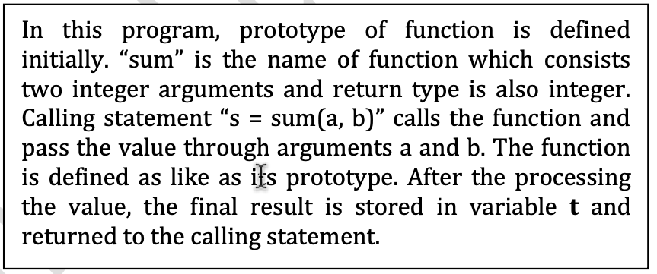
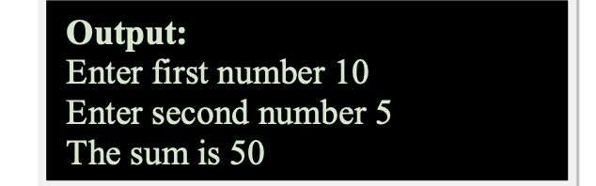
Example-1. Write a program to input any two numbers and find sum of the number.
#include<stdio.h>
int sum (int, int); //---------------------------- function prototype declaration
int main ( )
{
int a, b, s;
printf ("\n Enter first number");
scanf ("%d", &a);
printf ("\n Enter second number");
scanf ("%d", &b);
s = sum (a, b); //-------------------- calling function
printf ("\n The sum is %d", s);
return 0;
}
int sum (int a, int b) //------------ function defination
{
int t;
t = a + b;
return (t); //-------------------------- returning value//return statement
}
Function body
15

Slide 14
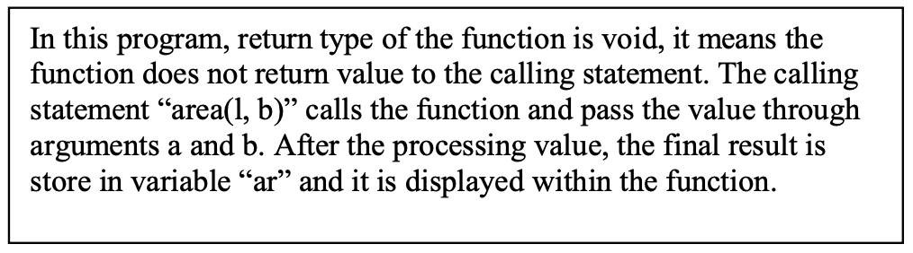
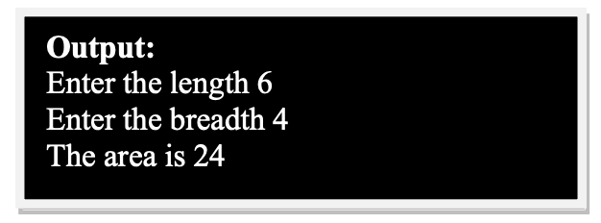
Void statement:
If a function does not return any value to the calling module, then it is called the function’s return type is void. In this function, the function accepts the values though the arguments and execute the result within the function after the manipulation with that values.
Example: Write a program to input length and breadth of rectangle and find area.
# include<stdio.h>
void area (int, int); // function prototype declaration
int main ( )
{
int l, b, s;
printf ("\n Enter the length");
scanf ("%d", & l);
printf ("\n Enter the breadth");
scanf ("%d", &b);
area(l, b); // Call the area function to compute and print the area
}
void area (int l, int b)
{
int ar;
ar = l*b;
printf ("\n The area is %d", ar);
}

Slide 15
(1) Accessing the function passing by value
The function can be used in different way. On the basis of passing value to the function and returning value to the calling module, the different method/categories of
User Defined Function can be defined as follow:
Functions passing arguments and returning value eg: int sum (int, int)
Functions passing arguments and not returning value. eg: void sum(int, int)
Function passing no arguments and returning value eg: int sum ( )
Function passing no arguments and returning no value: eg : void sum ()

Slide 16
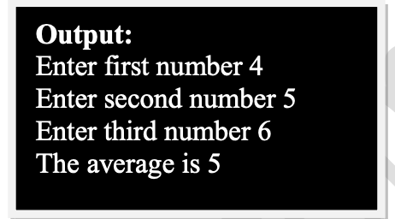
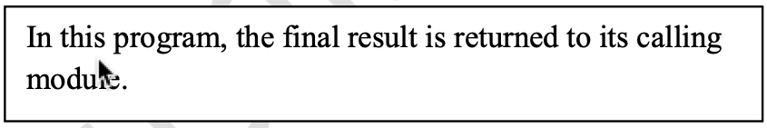
a. Functions passing arguments and returning value:In this method, the values are passed to the function through argument form the calling function. After the manipulation with value, the final value is returned to the calling module using return statement.
  Write a program to input any three numbers and find average
  # include<stdio.h>
  int average (int, int, int); //function prototype delcaration
  int main ( )
  {
  int a, b, c, d;
  printf ("\n Enter first number");
  scanf ("%d", & a);
  printf ("\n Enter second number");
  scanf ("%d", & b);
  printf ("\n Enter third number");
  scanf ("%d", & c);
  d = average (a, b, c); // function calling
  printf ("\n The average is %d", d);
  return 0;
  }
  int average (int a, int b, int c) // defination
  {
  int av;
  av = (a + b + c)/3;
  return (av); //returning value
  }
Function body

Slide 17
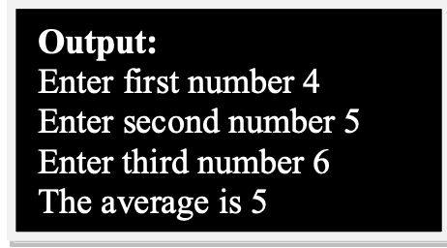
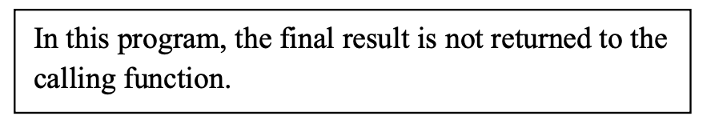
b) Functions passing arguments and not returning value:
In this method, the values are passed to the function through argument form the calling function. After the
manipulation with value, the final value is not returned to the calling module.
    Write a program to input any three numbers and find average of these numbers.
    # include<stdio.h>
    void average (int, int, int); //prototype
    int main ( )
    {
    int a, b, c;
    printf ("\n Enter first number");
    scanf ("%d", &a);
    printf ("\n Enter second number");
    scanf ("%d", &b);
    printf ("\n Enter third number");
    scanf ("%d", &c);
    average(a, b, c); //function call
    return 0;
    }
    void average (int a, int b, int c) //defination
    {
    int av;
    av = (a + b + c)/3;
    printf ("\n The average is %d", av);
    }
Function body

Slide 18
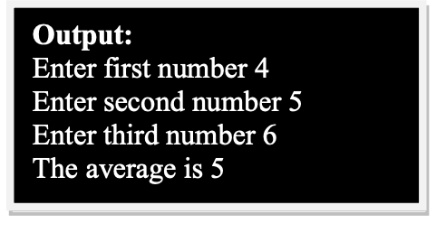
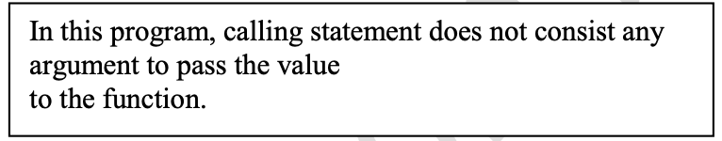
c) Function passing no arguments and yes returning value:
In this method, the values are not passed to the function through argument form the calling function. The inputs statements are used within the function for the value. The final value is returned to the calling module after the manipulation with that data.
        Write a program to input any three numbers and find average of these numbers.
        #include<stdio.h>
        int average ( ); //prototype
        int main ( )
        {
        int d;
        d = average ( ); //calling function
        printf ("\n The average is %d", d);
        return 0;
        }
        int average ( ) //defination
        {
        int a, b, c, av;
        printf ("\n Enter first number");
        scanf ("%d", & a);
        printf ("\n Enter second number");
        scanf ("%d", & b);
        printf ("\n Enter third number");
        scanf ("%d", & c);
        av = (a + b + c)/3;
        return (av); //return statement
        }
Function body

Slide 19
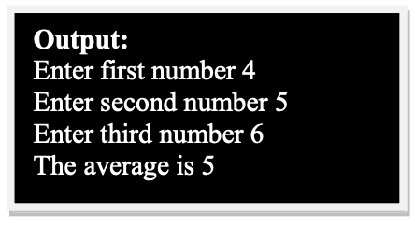
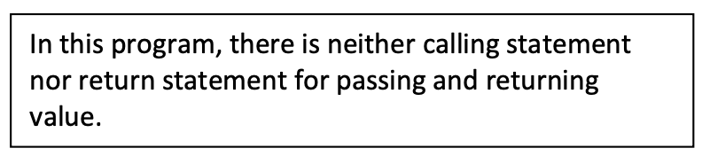
d. Function passing no arguments and returning no value:
In this method, the values are not passed to the function through argument fromm the calling function. The inputs statements are used within the function for the value. The final value is executed within function after the manipulation with that data.
Write a program to input any three numbers and find average of these numbers.
  # include<stdio.h>
  int average ( ); //prototype
  int main ( )
  {
  average ( );
  return 0;
  }
  int average ( ) //defination
  {
  int a, b, c, av;
  printf ("\n Enter first number");
  scanf ("%d", & a);
  printf ("\n Enter second number");
  scanf ("%d", & b);
  printf ("\n Enter third number");
  scanf ("%d", & c);
  av = (a + b + c)/3;
  printf ("\n The average is %d", av);
  }

Slide 20
Some Examples of Function

Slide 21
Write C program to find area and perimeter of a rectangle. Use function area_perimeter()
Write C program to know a number is even or odd using function named void even_odd(int )
Write C program to print multiplication table of a number using function void table( int)
Write C program to print factorial of a number using function void fact( int)
Write C program to print the greatest value among three numbers using a function int great(int int int). We have to use return statement
Write a C program to display fibonacci series using function as shown 1 1 2 3 5… upto n^{th} term.
Write C program to check and display the given number is prime or not.
Write C program to find sum of series 1, 3, 5,…..200 using function.
WAP to calculate and display sum of n numbers using array and function.
WAP to calculate and display to sum of two Metrix.

Slide 22
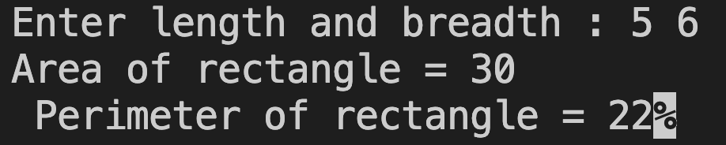
1.Write C program to find area and perimeter of a rectangle. Use function area_perimeter()
#include<stdio.h>
void area_perimeter(int , int );
int main()
{
int l, b;
printf("Enter length and breadth :");
scanf("%d%d",&l,&b);
area_perimeter(l,b);
return 0;
}
void area_perimeter(int l, int b)
{
int area,perimeter;
area=l*b;
printf("Area of rectangle = %d",area);
perimeter=2*(l+b);
printf("\n Perimeter of rectangle = %d",perimeter);
}
perimeter | area | l | b
22 | 30 | 5 | 6

Slide 23
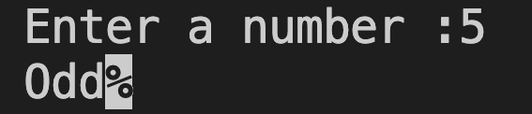
2.Write C program to know a number is even or odd using function named void even_odd(int )
#include<stdio.h>
void even_odd(int n);
int main()
{
int n;
printf("Enter a number :");
scanf("%d", &n);
even_odd(n);
return 0;
}
void even_odd(int n)
{
if(n%2==0)
printf("Even");
else
printf("Odd");
}
n
5

Slide 24
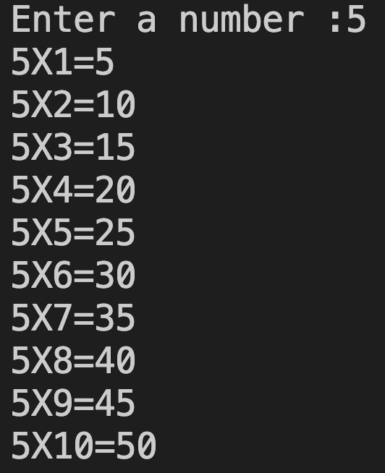
3.Write C program to print multiplication table of a number using function void table( int)
#include<stdio.h>
void table(int n);
int main()
{
int n;
printf("Enter a number :");
scanf("%d",&n);
table(n);
return 0;
}
void table(int n)
{
int i,m;
for(i=1;i<=10;i++)
{m=n*i;
printf("%dX%d=%d\n", n, i,m);
}
}
n | X | i | = | m
5 | x | 1 | = | 5
5 | x | 2 | = | 10
5 | x | 3 | = | 15
5 | x | 4 | = | 20
5 | x | 5 | = | 25
5 | x | 6 | = | 30
5 | x | 7 | = | 35
5 | x | 8 | = | 40
5 | x | 9 | = | 45
5 | x | 10 | = | 50

Slide 25
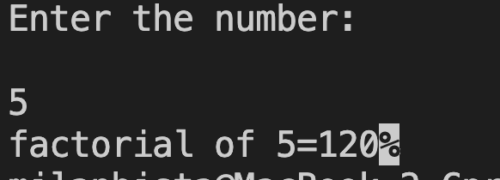
4. Write C program to print factorial of a number using function void fact( int)
#include<stdio.h>
void fact(int);
int main()
{
int n;
printf("enter any no:");
scanf("%d",&n);
fact(n);
return 0;
}
void fact(int n)
{ int f=1,i;
for (i=1;i<=n;i++)
{
f=f*i;
}
printf("factorial=%d",f);
}
n=5--> 1x2x3x4x5=120
f | x | i | = | f
1 | x | 1 | = | 1
1 | x | 2 | = | 2
2 | x | 3 | = | 6
6 | x | 4 | = | 24
24 | x | 5 | = | 120

Slide 26
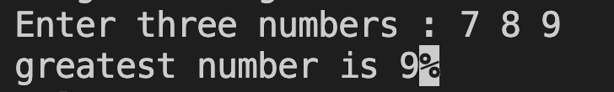
5.Write C program to print the greatest value among three numbers using a function int great(int int int). We have to use return statement
#include<stdio.h>
int great(int a, int, int c);
int main()
{
int a, b, c, d;
printf("Enter three numbers : ");
scanf("%d%d%d", &a, &b, &c);
d=great(a, b, c);
printf("greatest number is %d", d);
return 0;
}
int great(int a, int b, int c)
{
if(a>b && a>c)
{return a;}
else if (b>c)
{return b;}
else
{return c;}
}

Slide 27
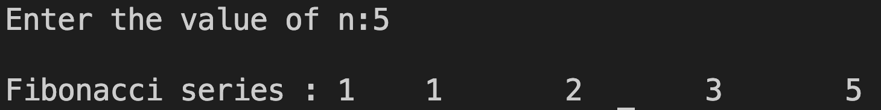
6.Write a C program to display fibonacci series using function as shown 1 1 2 3 5… upto n^{th} term.
#include <stdio.h>
void fib(int n);
int main()
{
int n;
printf("\nEnter the value of n:");
scanf("%d", &n);
fib(n);
return 0;
}
void fib(int n)
{
int i, a = 0, b = 1, c = 1;
printf("\nFibonacci series : ");
for (i = 1; i <= n; i++)
{
printf("%d\t", c);
c = a + b;
a = b;
b = c;
}
}
 | 0 | 1 | 1 | 2 | 3 | 5
i=1 | a | + b | =c
 | i=2 | a | + b | =c
 |  | i=3 | a | + b | =c
 |  |  | i=4 | a | + b | =c
 |  |  |  | i=5
It proves
c=a+b
a=b
b=c
n
5
a=0 | b=1 | c=1
i=1 | when i<=5 it first print c=1
 |  | c | = | a | + | b | a | = | b | = | c
 |  | 1 | = | 0 | + | 1 | 1 |  | 1 |  | 1
i=2 | print c=1 | c | = | a | + | b | a | = | b | = | c
 |  | 2 | = | 1 | + | 1 | 1 |  | 2 |  | 2
i=3 | print c=2 | c | = | a | + | b | a | = | b | = | c
 |  | 3 | = | 1 | + | 2 | 2 |  | 3 |  | 3
i=4 | print c=3 | c | = | a | + | b | a | = | b | = | c
 |  | 5 | = | 2 | + | 3 | 3 |  | 5 |  | 5
i=5 | print c=5 | c | = | a | + | b | a | = | b | = | c
i=6 | When 6<=5 condition false and stop print c=8 | 8 | = | 3 | + | 5 | 3 |  | 8 |  | 8

Slide 28
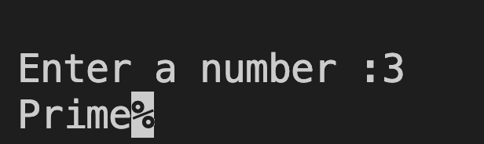
7.Write C program to check and display the given number is prime or not.
#include <stdio.h>
void test(int n);
int main()
{
int n;
printf("Enter a number: ");
scanf("%d", &n);
test(n);
return 0;
}
void test(int n)
{
if(n <= 1)
{
printf("Neither prime nor composite");
}
int i, f = 0;
for(i = 1; i <= n; i++)
{
if(n % i == 0)
{ f++;}
}
if(f == 2)
{ printf("Prime"); }
else
{ printf("Composite"); }
}
i++ i.e i=i+1 | i<=n | n | % | i | = | = | 0 | f=0 f++ | f==2
i=1 | 1<=3 true | 3 % 1 =0 |  |  | = | = | 0 | f=1
i=2 | 2<=3 true | 3 % 2 =1 |  |  | = | = | 0
i=3 | 3<=3 true | 3 % 3 =0 |  |  | = | = | 0 | f=2 | i.e 2==2
i=4 | 4<=3 false | exit from loop and compare f==2 i.e 2==2 which print prime Other wise print composite

Slide 29

8.Write C program to find sum of series 1, 3, 5,…..200 using function.
#include<stdio.h>
int sum();
int main()
{
printf("the sum is=%d", sum());
return 0;
}
int sum()
{
int s=0, i;
for(i=1; i<=200; i+=2)
{
s=s+i;
}
return s;
}
i=1 | S=0
i=i+2 | S | = | S | + | i
i=1 | 1 | = | 0 | + | 1
i=3 | 4 | = | 1 | + | 3
i=5 | 9 | = | 4 | + | 5
i=7 | 16 | = | 9 | + | 7
i=9 | 25 | = | 16 | + | 9
i=11 | 36 | = | 25 | + | 11
i=13 | 49 | = | 36 | + | 13
i=199 | 10000 | = | 9801 | + | 199

Slide 30
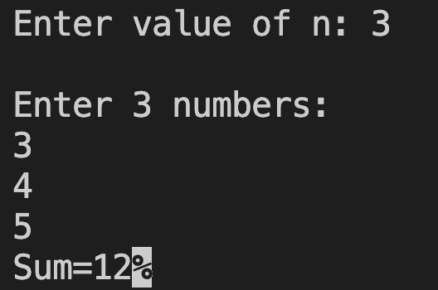
9.WAP to calculate and display sum of n numbers using array and function.
#include<stdio.h>
void add(int a[], int n);
int main()
{
int a[100], i, n;
printf("\nEnter value of n: ");
scanf("%d", &n);
printf("\nEnter %d numbers:\n",n);
for(i=0; i<n; i++)
{
a[0] a[1]
scanf("%d", &a[i]);
}
add(a, n);
return 0;
}
void add(int a[], int n)
{
int sum=0, i;
for(i=0; i<n; i++)
{ sum=sum+ a[i];
}
printf(”sum=%d", sum);
}
a[2] a[3] a[4] a[5] a[6] a[7] a[8] ----- a[99]
n
3
sum
0
3 | 4 | 5
sum | = | sum | + | a[i] | a[i] | i
3 | = | 0 | + | 3 | a[0] | i=0
7 | = | 3 | + | 4 | a[1] | i=1
12 | = | 7 | + | 5 | a[2] | i=2
When i<3 condition false and exit from loop |  |  |  |  |  | i<n i.e.i<3

Slide 31
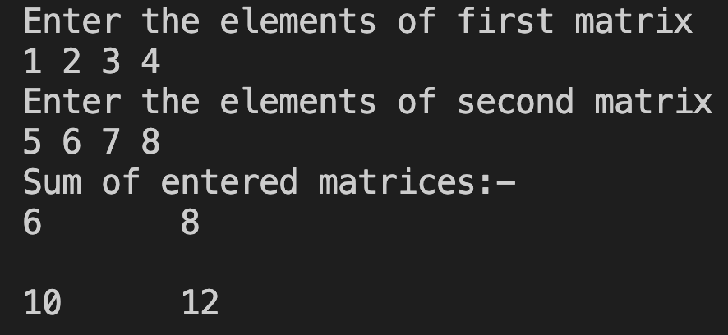
10.WAP to calculate and display to sum of two Metrix.
#include<stdio.h>
void matrix_sum(int m[2][2],int n[2][2]);
int main()
{
int i, j, m[2][2], n[2][2];
printf("Enter the elements of first matrix\n");
for(i=0;i<2;i++) m[i][j]
{ m[0][0] m[0][1]
for(j=0;j<2;j++)
{
scanf("%d", &m[i][j]);
}
} m[1][0] m[1][1]
printf("Enter the elements of second matrix\n");
for(i=0;i<2;i++)
{ n[i][j]
for(j=0;j<2;j++) n[0][0] n0][1]
{
scanf("%d",&n[i][j]);
}
}
matrix_sum(m,n);
return 0; n[1][0] n[1][1]
}
void matrix_sum(int m[2][2],int n[2][2])
{
m[i][j] n[i][j] sum[i][j]
int sum[2][2], i, j; m[0][0] m[0][1] n[0][0] n[0][1] sum[0][0] sum[0][1]
for(i=0;i<2;i++)
{ + =
for(j=0;j<2;j++)
{
sum[i][j]= m[i][j]+ n[i][j]; m[1][0] m[1][1] n[1][0] n[1][1] sum[1][0] sum[1][1]
}
}
printf("Sum of entered matrices:-\n");
for(i=0;i<2;i++)
{
for(j=0;j<2;j++)
{
printf("%d\t", sum[i][j]);
}
printf("\n\n");
}
}
1 | 2
3 | 4
5 | 6
7 | 8
6 | 8
10 | 12
1 | 2
3 | 4
5 | 6
7 | 8

Slide 32
Recursive function
It is process by which function call itself repeatedly, until some condition has been satisfied. For the problem to solve recursively two conditions must be satisfied: The function should call itself.
The problem statement must include a stopping condition.

Slide 33
Recursive Function LAB WORK
1.W rite C program to print factorial of a number using recursive function.
2.Write C program to print fibonacci series upto nth term of a number using recursive function.
3. Write C program to print Sum of ‘n’ numbers using recursive function.

Slide 34
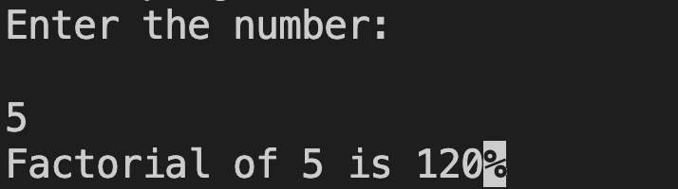
Write C program to print factorial of a number using recursive function.
#include<stdio.h>
int factorial(int n);
int main()
{
int n,f;
printf("Enter the number:\n\n");
scanf("%d",&n);
f=factorial(n);
if (f<0)
{
printf("no factorial for negation");
}
else
{
printf("Factorial of %d is %d",n,f);
}
return 0;
}
Rough only
factorial(n)=n*factorial(n-1)
factorial(5)=5*factorial(4)---eqn 1
factorial(4)=4*factorial(3)
factorial(3)=3*factorial(2)
factorial(2)=2*factorial(1)
factorial(1)=1
Now put value of factorial (1)=1
In above
From eqn( 1)
We get,
factorial(5)=120
int factorial(int n)
{
if(n==0|| n==1)
{
return 1; //factorial(n)=1
}
else if (n<0)
{
return n; // factorial(n)=n
}
else
{
return(n*factorial(n-1));}
}
v

Slide 35
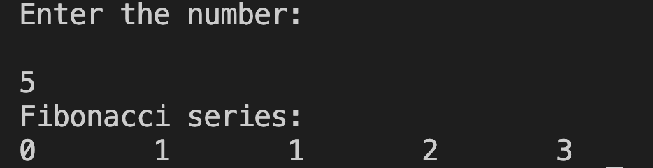
2.Write C program to print fibonacci series upto nth term of a number using recursive function.
#include<stdio.h>
int fab(int n);
int main()
{
int i, n;
printf("Enter the number:\n\n");
scanf("%d",&n);
printf("Fibonacci series:\n");
for(i=0; i<n; i++)
{
printf("%d\t", fab(i));
}
return 0;
}
int fab(int n)
{
if(n==0|| n==1)
{
return(n);
}
else
{
return(fab(n-1)+fab(n-2));
}
}
Rough only
If (n==0||n==1)
return fab(0)=0---------eqn 1
fab(1)=1--------eqn 2
else return
fab(n)= (fab(n-1)+fab(n-2))------eqn n
fab(2)= (fab(1)+fab(0))
fab(2) = 1+0=1--------eqn 3
fab(3)= (fab(2)+fab(1))
fab(3)= 1+1=2--------eqn 4
fab(4)= (fab(3)+fab(2))
fab(4)=2+1=3 --------eqn 5

Slide 36
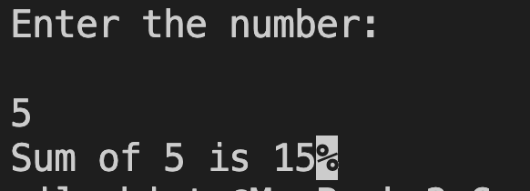
3.Write C program to print Sum of ‘n’ numbers using recursive function.
#include<stdio.h>
int sum(int n);
int main()
{
int n;
printf("Enter the number:\n\n");
scanf("%d",&n);
printf("Sum of %d is %d",n,sum(n));
return 0;
}
Rough only
neturn
n+sum(n-1)
sum(5)=5+sum(4)→eqn 1
sum(4)=4+sum(3)
sum(3)=3+sum(2)
sum(2)=2+sum(1)
sum(1)=1
int sum(int n)
{
if(n==0|| n==1)
{
return(n);
}
else
{
n=n+sum(n-1);
return(n);
}
}

Slide 37
Structure
Structure is defined as the collection of dissimilar data items treated as single unit. Each data item is called member of structure. The keyword struct is used to declare structure variable and type of structure variable is defined by tag_name of the structure. It is collection of heterogeneous data items treated as a single unit. Each data item is called member of structure.
Some major features of structure:
a. It can be treated as record that is collection of interrelated data fields having different data types.
b. It is possible to copy one structure variable to another by simply assignment operator (=).
c. It allows nested structure that is one structure inside another structure. d. It is possible to pass structure variable as parameter to any function. e. It is possible to define structure pointer also known as link list.

Slide 38
Syntax for structure declaration:
struct tag_name
{
datatype member1; datatype member2; --------------------
datatype memberN; };
struct tag_name var1, var2,……,varN;
Example for structure variable:
struct student
{
int rollNo;
char fName[20];
char lName[20];
};
struct student s1, s2, s3;
Syntax for structure declaration:
struct tag_name
{
datatype member1; datatype member2; --------------------
datatype memberN; }var1, var2,……,varN;
Example for structure variable:
struct student
{
int rollNo;
char fName[20];
char lName[20];
} s1, s2, s3;

Slide 39
Structure LAB Work
Write a C Program to store a student records like rollNo, name and address using structure variable.
Write a C Program using structure variable to store n students records like rollNo, name and address using array and loop.
Program to store n students records like name and address using array and loop. Print the sorted record on the basis of name.
Program to store n students records like name and address using array and loop. Print the sorted record in ascending order on the basis of rollno.
Program to store n students records like name, address and age using array and loop. Print the record on the basis of age between 20 and 30.
Write a program to calculate sum of two distances and distance is measured in terms of feet and inch using structure.
Write a program that takes roll_no,fname,lname and date of birth and output the information on screen using nested structure
WAP to input n students id, name, address and age. Then search record on the basis of id.
WAP to input n students id, name, address and age. Then search record on the basis of name.

Slide 40
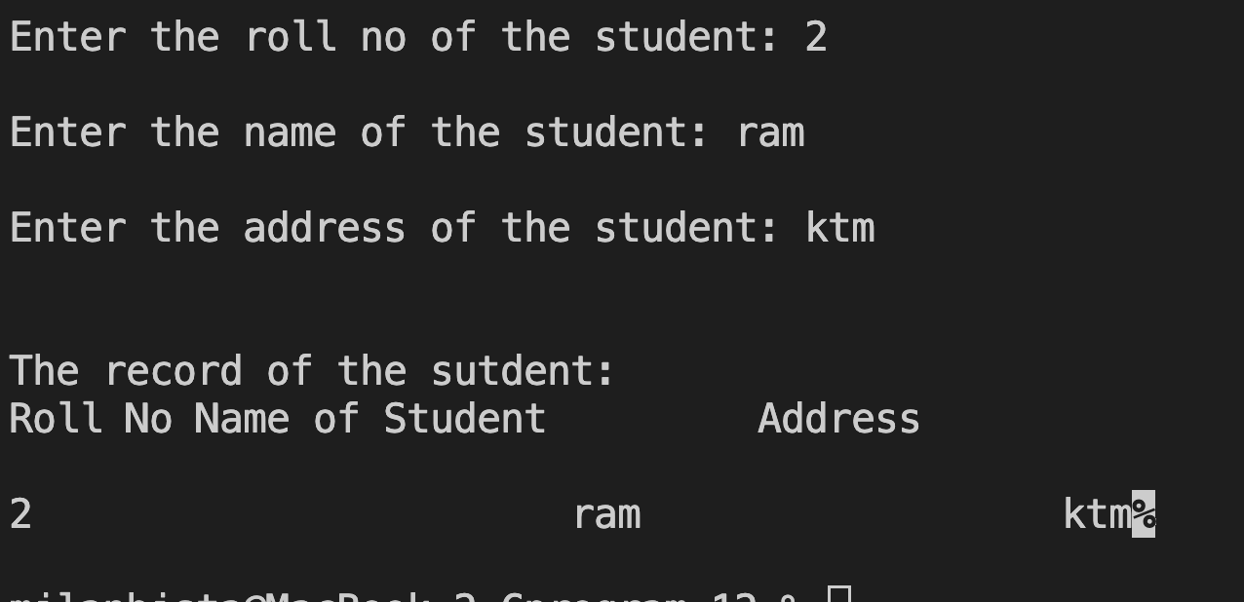
1. Write a C Program to store a student records like rollNo, name and address using structure variable.
//code to display after sorting
printf("\n\nThe record of the sutdent: ");
printf("\nRoll No\t\tName of Student\t\tAddress");
printf("\n\n%d \t\t\t%s\t\t\t%s",st.rollNo, st.name, st.adr);
return 0;
}
student
#include<stdio.h>
struct student
{
int rollNo;
char name[50];
char adr[60];
};
struct student st;
int main()
{ //code to input to structure
printf("\nEnter the roll no of the student: ");
scanf("%d", &st.rollNo);
printf("\nEnter the name of the student: ");
scanf("%s", st.name);
printf("\nEnter the address of the student: ");
scanf("%s", st.adr);
st.rollNo | 2
st.name[50] | 0 | 1 | 2 | 3 | 4 | 5 | 6--------49
 | r | a | m
st.adr[60] | 0 | 1 | 2 | 3 | 4 | 5 | 6--------59
 | k | t | m

Slide 41
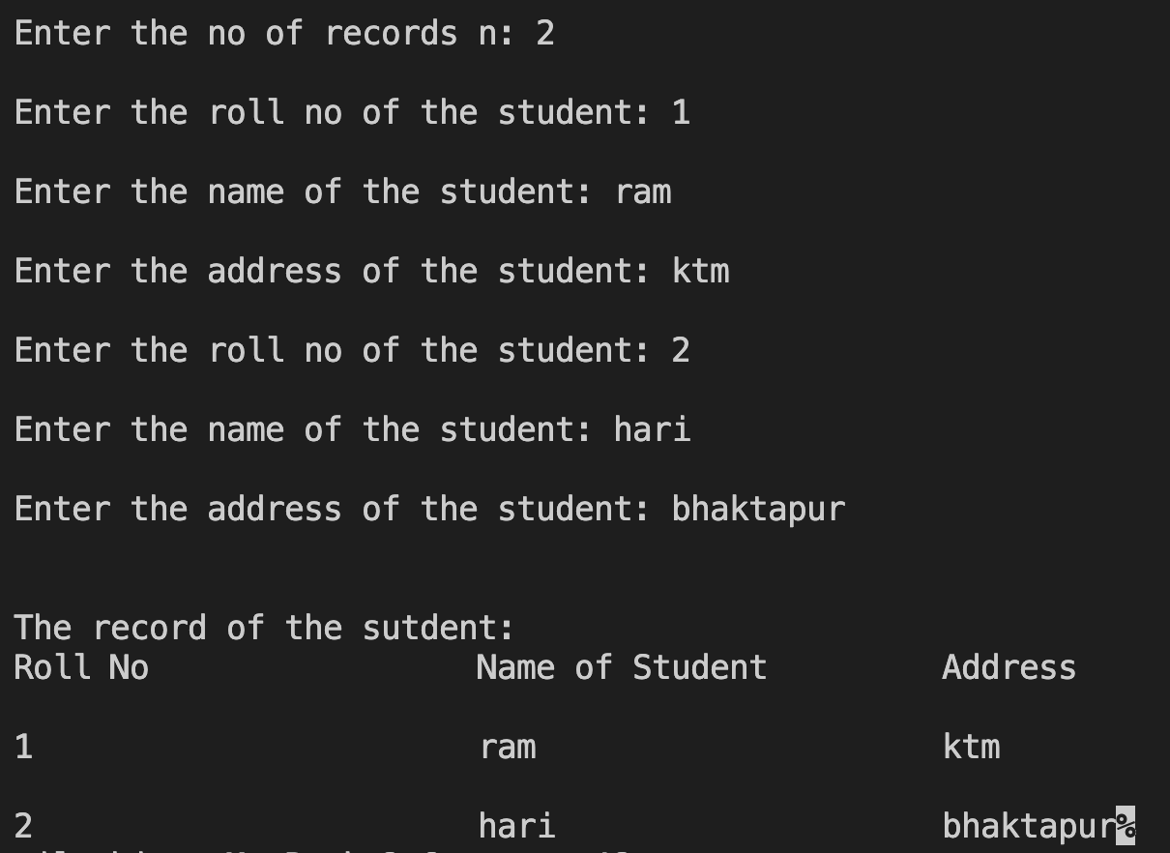
2. Write a C Program using structure variable to store n students records like rollNo, name and address using array and loop.
#include<stdio.h>
struct student
{
int rollNo;
char name[50];
char adr[60];
}st[100];
int main()
{
int i, n;
printf("\nEnter the no of records n: ");
scanf("%d", &n);
//code to input to structure
for(i=0; i<n; i++)
{
printf("\nEnter the roll no of the student: ");
scanf("%d", &st[i].rollNo);
printf("\nEnter the name of the student: ");
scanf("%s", st[i].name);
printf("\nEnter the address of the student: ");
scanf("%s", st[i].adr);
}
//code to display records
printf("\n\nThe record of the sutdent: ");
printf("\nRoll No\t\t\tName of Student\t\tAddress");
for(i=0; i<n; i++)
{
printf("\n\n%d \t\t\t%s\t\t\t%s",st[i].rollNo, st[i].name, st[i].adr);
}
return 0;
}

Slide 42
student
Qn 2
st[i].rollNo
st[0].rollNo | 1
st[1].rollNo | 2
st[2].rollNo
st[99].rollNo
st[i].name[50] st[0].name st[1].name st[2].name st[99].name | 0 | 1 | 2 | 3 | 4 | 5 | 6--------49
 | r | a | m
 | h | a | r | i
st[i].adr[60] st[0].adr st[1].adr st[2].adr st[99].adr | 0 | 1 | 2 | 3 | 4 | 5 | 6--------59
 | k | t | m
 | b | h | a | k | t | a | p | u | r

Slide 43
3. Program to store n students records like name and address using array and loop. Print the sorted record on the basis of name.
//code to arrange in alphabetic order using nested loop
for(i=0; i<n-1; i++)
{
for(int j=i+1; j<n; j++)
{
if(strcmp(st[i].name, st[j].name)>0)
{
temp=st[i];
st[i]=st[j];
st[j]=temp;
}
}
}
//code to display after sorting
printf("\n\nThe record of the sutdent after sorting: ");
printf("\nROLL\t\tName of Student\t\tAddress");
for(i=0;i<n;i++)
{
printf("\n\n%d\t\t%s\t\t\t%s",st[i].rollNo,st[i].name,st[i].adr);
} return 0;
}
#include<stdio.h>
#include<string.h>
struct student
{
int rollNo;
char name[50];
char adr[60];
}st[100];
int main()
{ struct student temp;
int i, n;
{
printf("\nEnter the no of records n: ");
scanf("%d", &n);
}
//code to input to structure
for(i=0; i<n; i++)
{
printf("\nEnter the roll no of the student: ");
scanf("%d", &st[i].rollNo);
printf("\nEnter the name of the student: ");
scanf("%s", st[i].name);
printf("\nEnter the address of the student: ");
scanf("%s", st[i].adr);
}

Slide 44
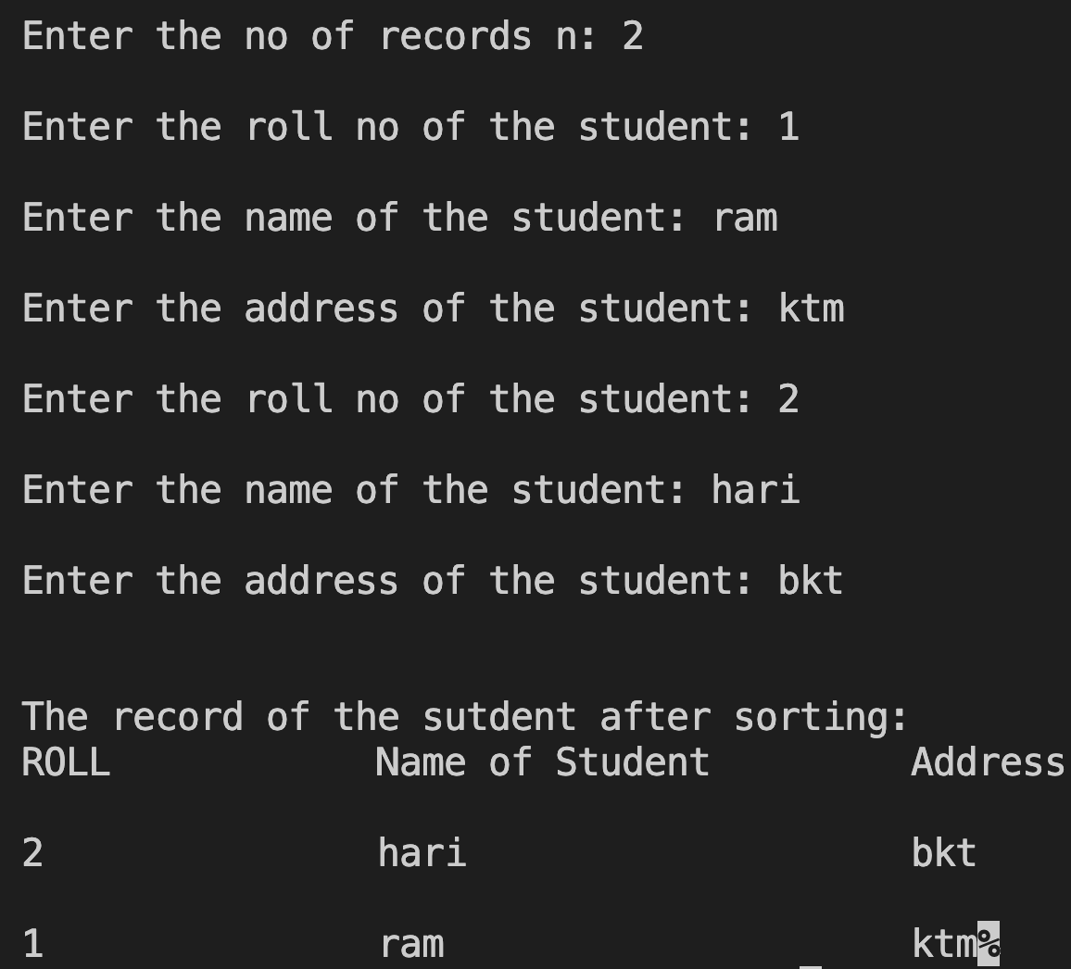
QN 3
TEMP | st[i].rollNo |  | 1 | 1
 | st[i].name |  | r | r | a | a | m
 | st[i].adr |  | k | k | t | t | m
st[i].rollNo
st[0].rollNo | 2
st[1].rollNo | 1
st[2].rollNo
st[99].rollNo
st[i].name[50] st[0].name st[1].name st[2].name st[99].name | 0 | 1 | 2 |  | 3 |  | 4 | 5 | 6--------49
 | h | a | r |  | i
 | r | a | m
st[i].adr[60] st[0].adr st[1].adr st[2].adr st[99].adr | 0 | 1 | 2 |  | 3 |  | 4 | 5 | 6--------59
 | b | k | t
 | k | t | m
Output
st[i]
st[j]
st[i]
st[j]
student
st[i]
st[j]

Slide 45
4. Program to store n students records like name and address using array and loop. Print the sorted record in ascending order on the basis of rollno.
//code to arrange in ascending order of rollno using nested loop
for(i=0; i<n-1; i++)
{
for(int j=i+1; j<n; j++)
{
if(st[i].rollNo>st[j].rollNo)
{
temp=st[i];
st[i]=st[j];
st[j]=temp;
}
}
}
//code to display after sorting
printf("\n\nThe record of the sutdent after sorting ");
printf("\nROLL\t\tName of Student\t\tAddress");
for(i=0;i<n;i++)
{
printf("\n\n%d\t\t%s\t\t\t%s",st[i].rollNo,st[i].name,st[i].adr);
} return 0;
}
#include<stdio.h>
struct student
{
int rollNo;
char name[50];
char adr[60];
}st[100];
int main()
{ struct student temp;
int i, n;
{
printf("\nEnter the no of records n: ");
scanf("%d", &n);
}
//code to input to structure
for(i=0; i<n; i++)
{
printf("\nEnter the roll no of the student: ");
scanf("%d", &st[i].rollNo);
printf("\nEnter the name of the student: ");
scanf("%s", st[i].name);
printf("\nEnter the address of the student: ");
scanf("%s", st[i].adr);
}

Slide 46
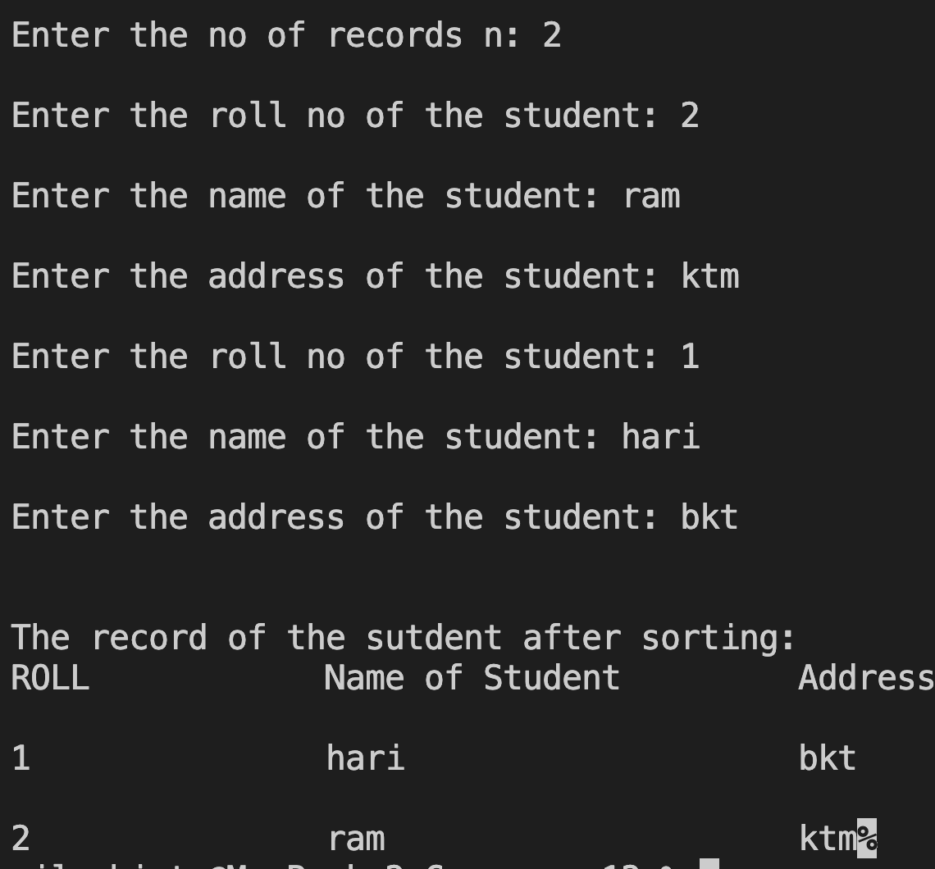
QN (4)
student
TEMP | st[i].rollNo |  | 2 | 2
 | st[i].name |  | r | r | a | a |  | m
 | st[i].adr |  | k | k | t | t |  | m
st[i].rollNo
st[0].rollNo | 1
st[1].rollNo | 2
st[2].rollNo
st[99].rollNo
st[i].name[50] st[0].name st[1].name st[2].name st[99].name | 0 | 1 | 2 |  | 3 |  | 4 |  | 5 |  | 6--------49
 | h | a | r |  | i
 | r | a | m
st[i].adr[60] st[0].adr st[1].adr st[2].adr st[99].adr | 0 | 1 | 2 |  | 3 |  | 4 |  | 5 |  | 6--------59
 | b | k | t
 | k | t | m
Output
st[i]
st[j]
st[i]
st[j]
st[i]
st[j]

Slide 47
5. Write a C Program using structure variable Program to store n students records like name, address and age using array and loop. Print the record on the basis of age between 20 and 30.
#include<stdio.h>
struct student
{
char name[50], adr[60];
int age;
};
int main()
{
struct student st[100], temp;
int i, j, n;
printf("\nEnter a number how many records you
want to input: ");
scanf("%d", &n);
//code to input to structure
for(i=0; i<n; i++)
{
printf("\nEnter the name of the student: ");
scanf("%s",st[i].name);
printf("\nEnter the address of the student: ");
scanf("%s",st[i].adr);
printf("\nEnter the age of the student: ");
scanf("%d", &st[i].age);
}
//code to display after sorting
printf("\nName of Student\t\tAddress\t\tAge ");
for(i=0;i<n;i++)
{
if(st[i].age>=20 && st[i].age<=30)
{
printf("\n\n%s\t\t\t%s\t\t%d",st[i].name,st[i].adr,st[i].age);
}
}
}

Slide 48
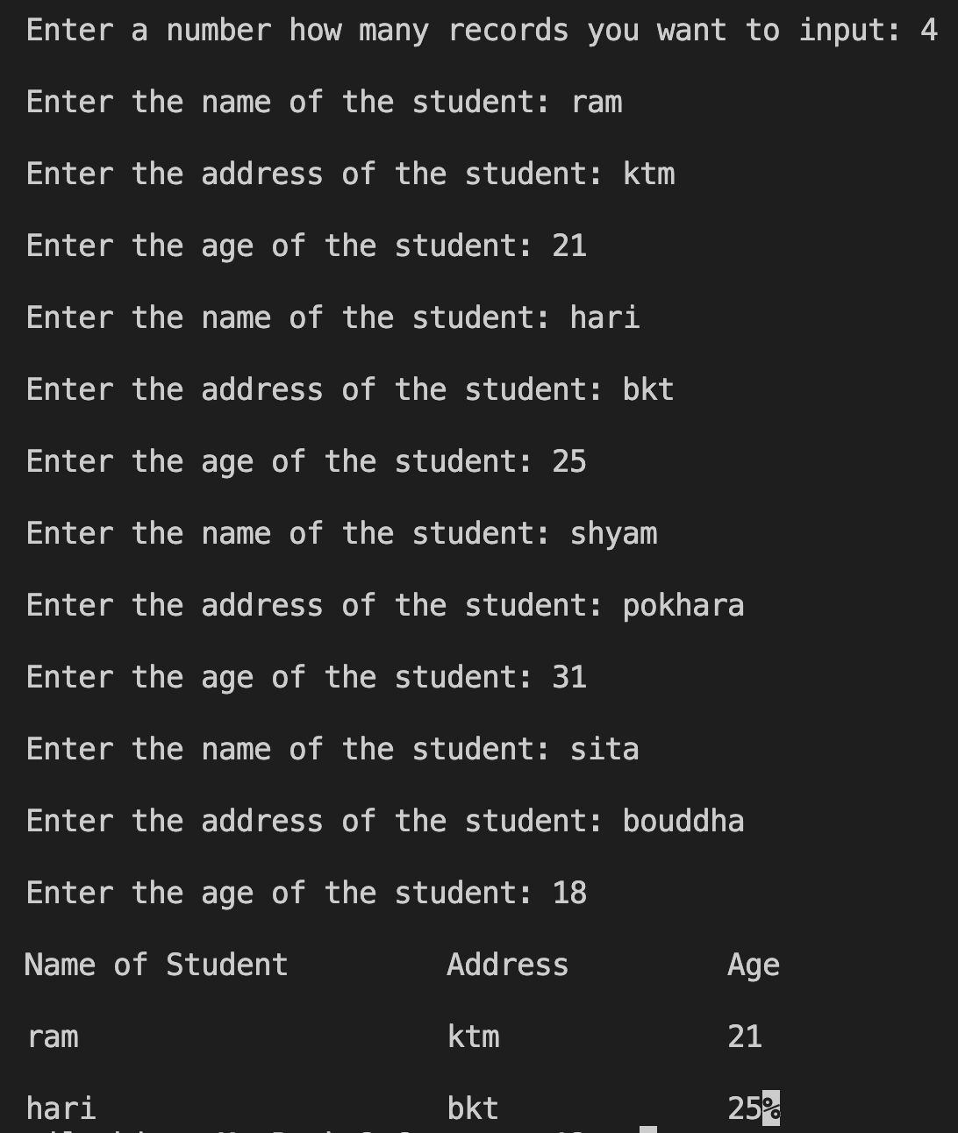
st[i].name[50] st[0].name st[1].name st[2].name st[3].name st[99].name | 0 | 1 | 2 | 3 | 4 | 5 | 6--------49
 | r | a | m
 | h | a | r | i
 | s | h | y | a | m
 | s | i | t | a
st[i].adr[60] st[0].adr st[1].adr st[2].adr st[3].adr st[99].adr | 0 | 1 | 2 | 3 | 4 | 5 | 6--------59
 | k | t | m
 | b | k | t
 | p | o | k | h | a | r | a
 | b | o | u | d | d | h | a
st[i].age
st[0].age | 21
st[1].age | 25
st[2].age | 31
st[3].age | 18
st[99.]age
QN(5)
student

Slide 49
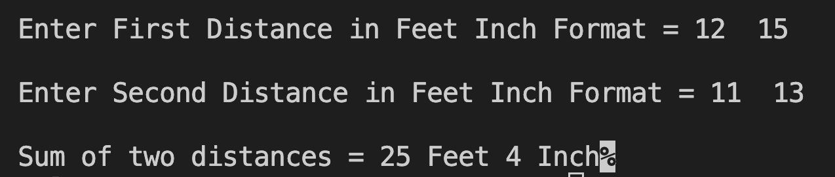
6. Write a program to calculate sum of two distances and distance is measured in terms of feet and inch using structure. distance
#include <stdio.h>
typedef struct
{
int feet;
int inch;
} distance;
int main()
{
distance d1, d2, d;
printf("\nEnter First Distance in Feet Inch Format = ");
scanf("%d%d", &d1.feet, &d1.inch);
printf("\nEnter Second Distance in Feet Inch Format = ");
scanf("%d%d", &d2.feet, &d2.inch);
d.inch = (d1.inch + d2.inch) % 12;
d.feet = d1.feet + d2.feet + (d1.inch + d2.inch) / 12;
printf("\nSum of two distances = %d Feet %d Inch", d.feet, d.inch);
return 0;
}
d.inch =4 | (d1.inch + d2.inch)%12
 | (15 + 13)%12
 | = 28%12
d.Feet =25 | d1.feet + d2.feet + Remaining feet (d1.inch+d2.inch)/12
 | 12 + 11 + = ( 28/ 12)
 | = 23 + = 2

Slide 50
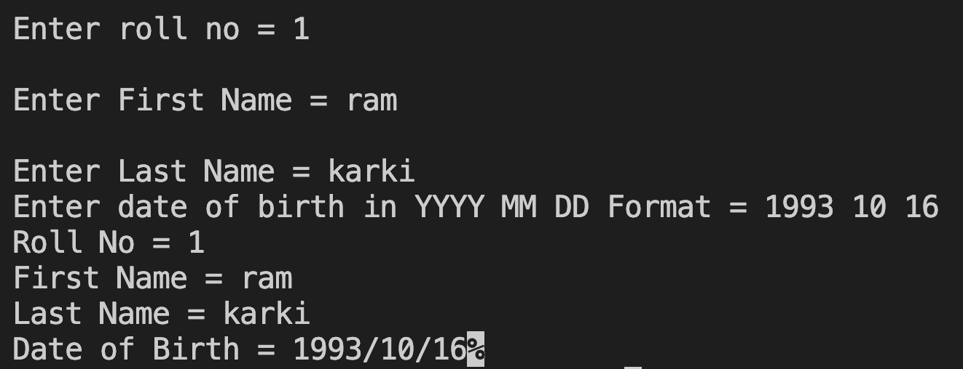
7. Write a program that takes roll_no,fname,lname and date of birth and output the information on screen using nested structure
#include <stdio.h>
struct date {
int year;
int month;
int day;
};
struct student {
int roll_no;
char fname[30];
char lname[30];
struct date d;
};
date
int main() {
struct student s;
printf("\nEnter roll no = ");
scanf("%d", &s.roll_no);
printf("\nEnter First Name = ");
scanf("%s", s.fname);
printf("\nEnter Last Name = ");
scanf("%s", s.lname);
printf("Enter date of birth in YYYY MM DD Format = ");
scanf("%d%d%d", &s.d.year, &s.d.month, &s.d.day);
printf("Roll No = %d\nFirst Name = %s\nLast Name = %s\nDate of Birth =%d/%d/%d",
s.roll_no, s.fname, s.lname, s.d.year, s.d.month, s.d.day);
return 0;
}
student
s.roll_no | 1
s.fname[30] | 0 | 1 | 2 | 3 | 4 | 5 | 6--------29
 | r | a | m
s.lname[30 | 0 | 1 | 2 | 3 | 4 | 5 | 6--------29
 | k | a | r | k | i
s.d.year | 1993
s.d.month | 10
s.d.day | 16

Slide 51
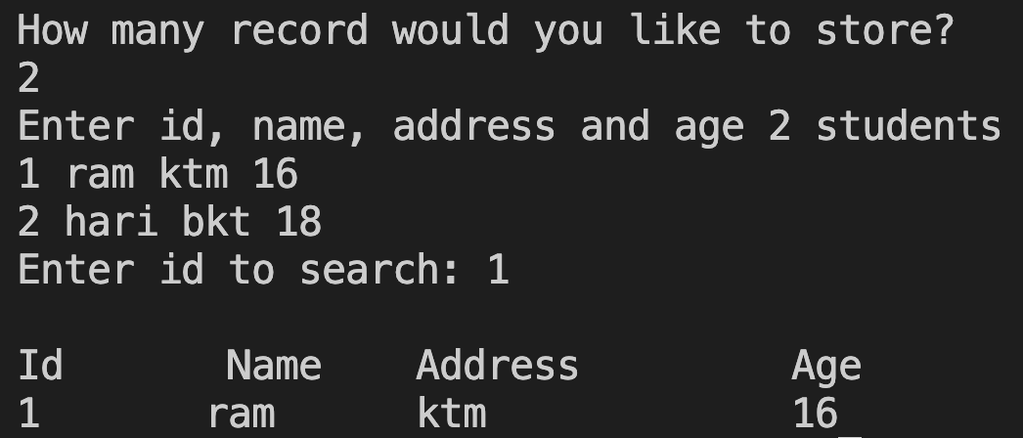
8.WAP to input n students id, name, address and age. Then search record on the basis of id.
#include<stdio.h>
struct student
{
int id;
char name[30];
char address[30];
int age;
}s[20];
int main()
{
int i, n, search;
printf("How many record would you like to store? \n");
scanf("%d", &n);
printf("Enter id, name, address and age %d students\n", n);
for(i=0; i<n; i++)
{
scanf("%d%s%s%d", &s[i].id, s[i].name, s[i].address, &s[i].age);
}
printf("Enter id to search: ");
scanf("%d", &search);
printf("\n Id \t Name\t Address\t Age\n");
for(i=0; i<n; i++)
{
if(s[i].id == search)
printf("%d %s\t %s\t %d\n", s[i].id, s[i].name, s[i].address, s[i].age);
}
return 0;
}

Slide 52
st[i].id
st[0].id | 1
st[1].id | 2
st[19].id
st[i].name[30] st[0].name st[1].name st[19].name | 0 | 1 | 2 | 3 | 4 | 5 | 6 7----29
 | r | a | m
 | h | a | r | i
st[i].adr[30] st[0].adr st[1].adr st[19].adr | 0 | 1 | 2 | 3 | 4 | 5 | 6 7-----29
 | k | t | m
 | b | k | t
st[i].age
st[0].age | 16
st[1].age | 18
st[19].address
search
1
QN (8)
student

Slide 53
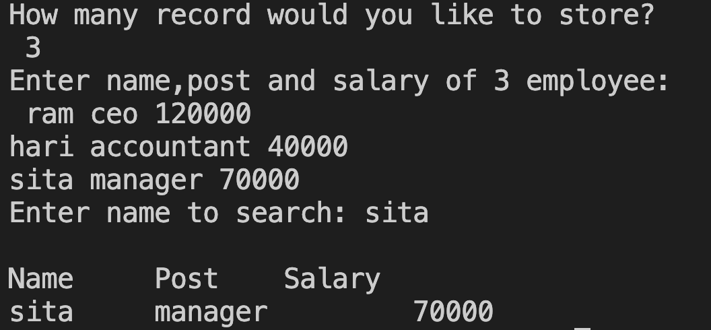
9.WAP to input n students id, name, address and age. Then search record on the basis of name.
#include<stdio.h>
#include<string.h>
struct employee
{
char name[30];
char post[30];
int salary;
}emp[20];
int main()
{
int i, n;
char search[30];
printf("How many record would you like to store?\n ");
scanf("%d", &n);
printf("Enter name,post and salary of %d employee:\n ", n);
for(i=0; i<n; i++)
{
scanf("%s%s%d", emp[i].name, emp[i].post, &emp[i].salary);
}
printf("Enter name to search: ");
scanf("%s", search);
printf("\nName\t Post\t Salary\n");
for(i=0; i<n; i++)
{
if(strcmp(emp[i].name,search)==0) // this means if both string are same
printf("%s\t %s\t %d\n",emp[i].name,emp[i].post,emp[i].salary);
}
return 0;
}

Slide 54
emp[i].name[30] emp[0].name emp[1].name emp[2].name emp[19].name | 0 | 1 | 2 | 3 | 4 | 5 | 6 | 7 | 8 | 9 | 10….29
 | r | a | m
 | h | a | r | i
 | s | i | t | a
emp[i].post[30] emp[0].post emp[1].post emp[2].post emp[19].post | 0 | 1 | 2 | 3 | 4 | 5 | 6 | 7 | 8 | 9 | 10…..29
 | c | e | o
 | a | c | c | o | u | n | t | a | n | t
 | m | a | n | a | g | e | r
emp[i].salary
emp[0].salary | 120000
emp[1].salary | 40000
emp[2].salary | 70000
emp[19].salary
search
sita
QN (9)
student

Slide 55
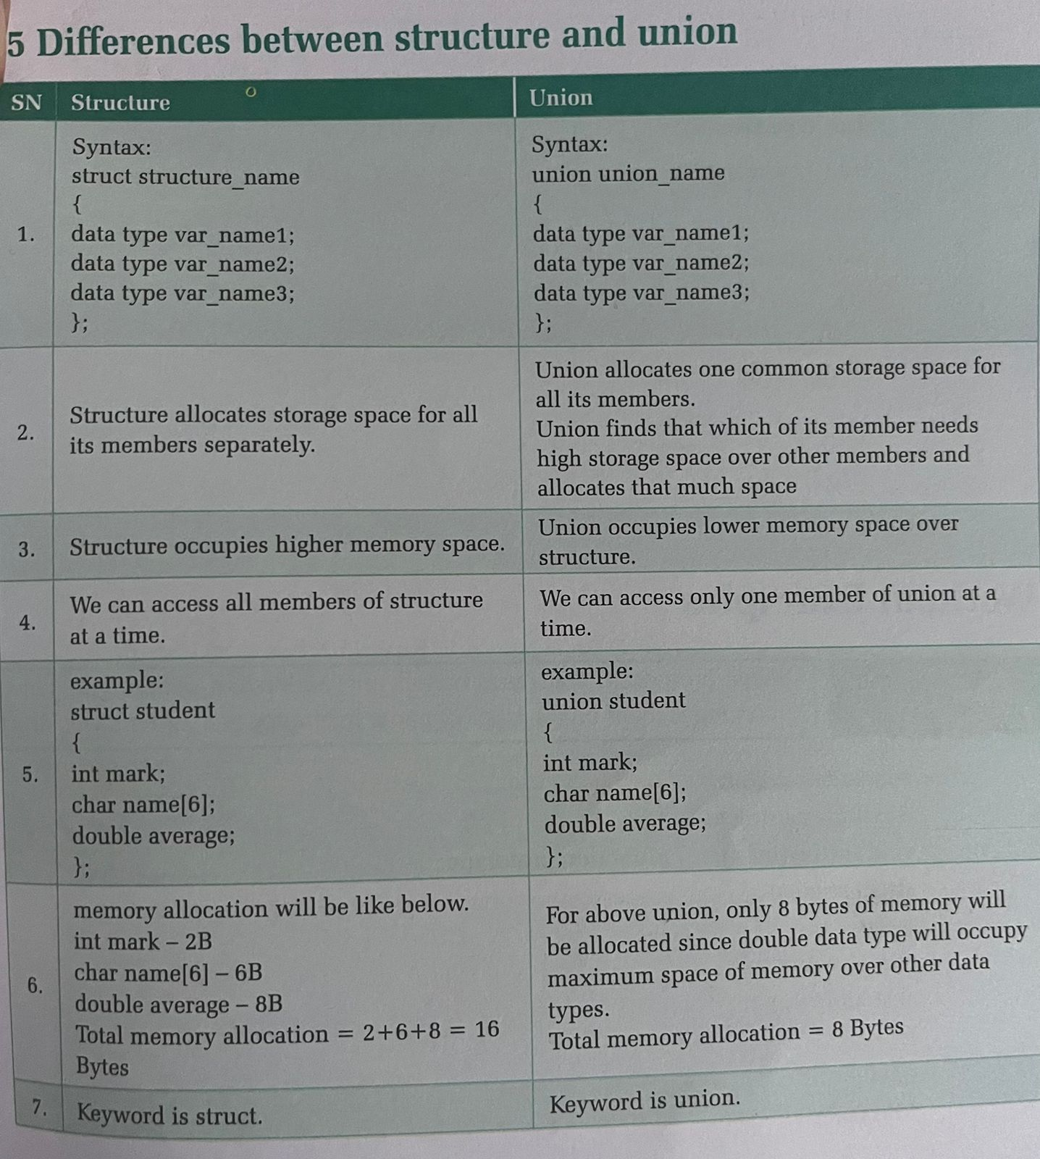

Slide 56
Differentiate between Library and User Defined Function
SN | Library Function | User-defined Function
1 | Library functions are pre-defined functions. | User-defined functions are created by the programmer according to the need.
2 | Requires header file to use. | Requires function prototype to use.
3 | Program development time is faster. | Program development time is slower.
4 | Called at run time. | Called at compile time.
5 | The name of library functions can’t be changed. | The name of user-defined functions can be changed.
6 | Programs using library functions are usually short. | Programs using user-defined functions are usually lengthy.
7 | Examples: printf(), scanf(), strupr(), strlen() etc. | Examples: day(), product(), sum(), diff() etc.

Slide 57
4) Pointers
Pointer is a variable that points to another variable which means it contains the memory address of another variable and is declared as the pointer type. It contains only the memory location of the variable rather than its contents.
A pointer is a special type of variable that represent memory address of a variable rather than its value.
Features of Pointer
Pointer saves memory space.
Pointer assigns the memory space and also releases it which makes the best use of the available memory.
The execution time is faster because data manipulation is done directly inside memory.
Manipulation of data at different memory locations is easier.
Dynamic memory allocation.

Slide 58
Declaring a pointer variable
To declare and refer a pointer variable, provides two special operators & and * . Address operator(ampersand): & This operator gives the memory address of the variable.
Indirection operator: *
This operator gives the value of the variable at the specified address. Example:
i = 100
i Memory address
i=100 memory address of i=1004
&i -> it points the memory address i.e., 1004
*i -> it points value of the variable i i.e., 100
Types of pointer variable declaration:
char *ptr, *name; pointer to character type variable int *ptr, *num; pointer to integer type variable float *ptr, *marks; pointer to float type variable char *address[50]; pointer to character array. Example:
100
1004

Slide 59
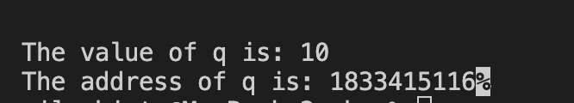
A sample program to demonstrate address and value.
#include<stdio.h>
int main()
{
int *p;
int q=10;
p = &q;
printf("The value of q is: %d", *p);
printf("\nThe address of q is: %d", p);
return 0;
}

Slide 60

1) WAP to sum two numbers 10 and 5 using pointers.
#include<stdio.h>
int main()
{
int *p, *q, a=10, b=5, sum;
p = &a;
q = &b;
sum = *p + *q;
printf("Sum is: %d", sum);
printf("\nSum is: %d", *p + *q);
return 0;
}

Slide 61
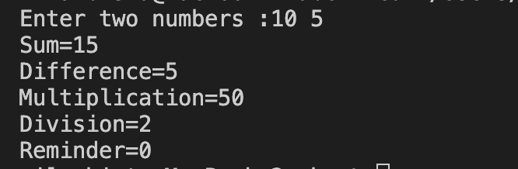
2) WAP to perform arithmetic calculations (sum, difference, multiplication and division) of two numbers using pointers.
#include<stdio.h>
int main()
{
int n1, n2, *x, *y;
printf("Enter two numbers :");
scanf("%d %d",&n1,&n2);
x=&n1;
y=&n2;
printf("Sum=%d\n", *x + *y);
printf("Difference=%d\n", *x - *y);
printf("Multiplication=%d\n", *x * *y);
printf("Division=%d\n", *x / *y);
printf("Reminder=%d\n", *x % *y);
return 0;
}

Slide 62

3)WAP to find odd or even number using pointers.
#include<stdio.h>
int main()
{
int num, *n;
printf("Enter any number: ");
scanf("%d", &num);
n=&num;
if(*n % 2==0)
printf("even");
else
printf("odd");
return 0;
}

Slide 63
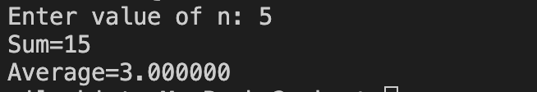
4)Write C program to find sum and average of ‘n’ natural numbers using pointer.
#include<stdio.h>
int main()
{
int *p;
int n, i, sum=0;
float avg=0;
printf("Enter value of n: ");
scanf("%d", &n);
p=&n;
for(i=1; i<=*p; i++)
{
sum=sum+i;
}
avg=sum/(*p);
printf("Sum=%d\n", sum);
printf("Average=%f\n", avg);
return 0;
}

Slide 64
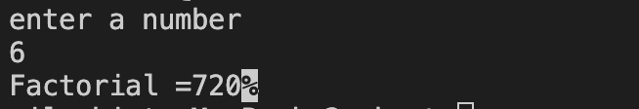
5)Write C program to find factorial of a number using pointer.
#include<stdio.h>
int main()
{
int *p, n, i, fact=1;
printf("enter a number\n");
scanf("%d", &n);
p=&n;
for(i=1; i<=*p; i++)
{
fact= fact*i;
}
printf("Factorial =%d", fact);
return 0;
}

Slide 65
Pointer and Function
As we have studied about the function's arguments and parameters passing in function. They are passed in two ways:
1. Call by value
In this method values of the variables are passed. By using this method values of variable are not affected by changing the values of formal parameter. When an argument is passed by value the data item is copied to the function. So, any alternation made to the data item within the function is not carried in to the calling function.

Slide 66

6)Program to swap any two integers using call by value(IMP)
#include<stdio.h>
void swap(int a, int b);
int main()
{
int a = 10, b= 20;
swap(a,b); // Actual parameter
printf("Call by value\n");
printf(" After swapping a = %d and b= %d ", a, b);
return 0;
}
void swap(int a, int b) //Formal parameter
{
int t;
t = a;
a = b;
b = t;
}

Slide 67
2. Call by reference
In this method address of the variables are passed. The content of that address can be accessed freely either within the function or within the calling function so, by using this method values of variable are by changing the values of formal parameter. Moreover, any changes that is made to the data items will be recognized in both the function and calling routine.

Slide 68

7 )Program to show call by reference IMP
#include<stdio.h>
void swap(int *a, int *b);
int main()
{
int a = 10, b= 20;
swap(&a, &b);
printf("Call by reference\n");
printf(" After swapping a = %d and b= %d ", a, b);
return 0;
}
void swap(int *a, int *b)
{
int t;
t = *a;
*a = *b;
*b = t;
}

Slide 69
POINTER LAB WORK
WAP to sum two numbers 10 and 5 using pointers.
WAP to perform arithmetic calculations (sum, difference, multiplication and division) of two numbers using pointers.
WAP to find odd or even number using pointers.
Write C program to find sum and average of ‘n’ natural numbers using pointer.
Write C program to find factorial of a number using pointer.
Program to swap any two integers using call by value
7 )Program to show call by reference

Slide 70
Concept of data file
In previous unit we use the function scanf( ) to take data from keyboard and similarly the function printf( ) to display data on screen. In such programs, data is temporarily stored in main memory during the program execution. When the program is recompiled, the entire data have been lost. Therefore, in order to store data permanently we need data file. A data file is simply a file in hard disk which is used to store data permanently.
A data file is defined as a collection of data or information which is permanently stored inside secondary memory as a single unit. We can read, write, append and delete data in data file as per our requirement.

Slide 71
C language support various functions to perform various operations such as: defining file, opening file, writing file, reding file, appending file and closing file. fopen( ): to create new data file.
fclose( ): to close data file.
getc( ): to read a character from data file.
putc( ): to write a character to data file.
getw( ): to read an integer from data file.
putw( ): to write an integer to data file.
fscanf( ): to read formatted data from data file.
fprintf( ): to write formatted data to data file.
fread( ): to read record from data file.
fwrite( ): to write record to data file.
scanf( ) : to input formatted data from the keyboard.
printf( ) : to display formatted data on screen.
getchar( ) : to input a single character from the keyboard.
putchar( ) : to display a character on the screen.
gets( ) : to input string from the keyboard.
puts( ) : to display string on the screen.
Note: Except scanf() printf() fscanf() fprintf() all other input output functions are informatted I/O functions.

Slide 72
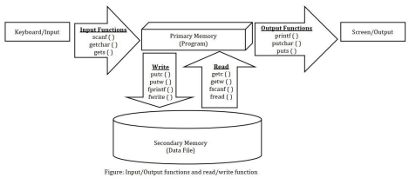

Slide 73
Defining and opening Data File
Syntax:
FILE *fp;
fp = fopen("filename.extension", "mode");
The keyword FILE is used to declare file data type. The first statement defines file pointer variable with data type FILE. The second statement create file with name 'filename' and returns memory address that is assigned to the file pointer fp. The mode defines the purpose of the file which can be one of the followings:
∙ r - open a file in read mode
∙ w - opens or create a text file in write mode
∙ a - opens a file in append mode
∙ r+ - opens a file in both read and write mode
∙ a+ - opens a file in both read and write/append mode
∙ w+ - opens a file in both read and write mode
Compiler automatically assigns special character at the end of the file EOF. Closing Data File
Syntax:
fclose( fp );

Slide 74
General guidelines for solving file related problems:
Step 1: Define file pointer variable with type FILE either inside or outside void main function.
FILE *fp;
Step 2: For the first time create new data file using fopen function in write mode. fp = fopen("filename.extension", "w");
Step 3: Take data from keyboard using input functions: scanf ( ), gets ( ), getchar ( ) and store data to the file using write functions: fprintf ( ), putc ( ), putw ( ) and fwrite ( ).
Step 4: During read operations, first open the data file in read mode.
Page 46 of 60
fp = fopen("filename.extension", "r");
Step 5: Read the data from data file using functions: fscanf ( ), getc ( ), getw ( ) and fread ( ) and display the data on the screen using output functions: printf ( ), puts ( ) and putchar ( ).
Step 6: Finally close the data file using function fclose( ).
fclose (fp);

Slide 75
putc( ) and getc( ) functions
putc( ) function is used for writing a character into a file.
Syntax:
putc (char ch, FILE *fp);
Example:
FILE *fp;
char ch;
putc(ch, fp);
getc( ) function is used to read a character from file.

Slide 76

Syntax:
char getc (FILE *fp);
Example:
FILE *fp;
char ch;
ch = getc(fp);

Slide 77
1) Write a C program using getc() and putc() to read characters from the keyboard, store them in a file named std1.txt until Ctrl+Z is pressed, and then display the file’s contents on the screen.
fp=fopen("std1.txt","r");
if (fp == NULL) {
printf("Error opening file for writing.\n");
return 0;
}
printf("text on the file:\n");
while ((ch=getc(fp))!=EOF) // reading each character from file
{putchar(ch); // displaying each character on to the screen
}
fclose(fp);
return 0;
}
#include<stdio.h>
int main()
{
char ch;
FILE *fp;
fp=fopen("std1.txt","w"); //opening file in write mode
if (fp == NULL) {
printf("Error opening file for writing.\n");
return 0;
}
printf("enter the text press cntrl z to stop\n");
while((ch = getchar())!=EOF)
{
putc(ch,fp); // writing each character into the file
}
fclose(fp);

Slide 78
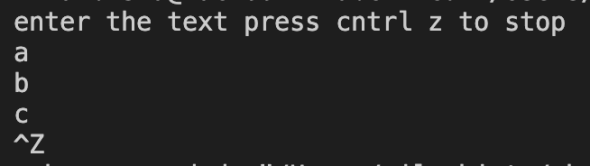
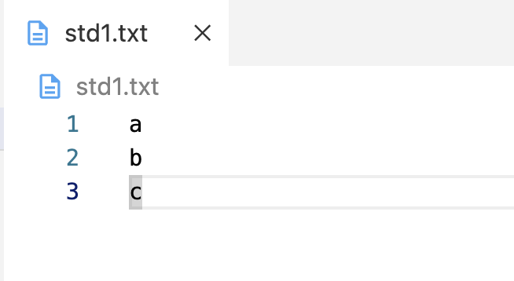
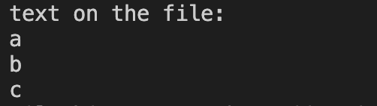
Note: putc() function is used to write single character to the file named “std1.txt” from memory.
Note: getchar() function is used to store /input single character to memory from userscreen.
Memory
User screen
File name “std1.txt” (Notepad)
ch
a b c
getchar()
putc()
putchar()
getc()
Note: putchar() function is use to display single character from Memory
Note: getc() function is used to store /input single character to memory from datafile “std1.txt”

Slide 79
2)Write a C program using putw() and getw() functions to store integers from 1 to 10 into a file named num.txt, and then read and display the contents of the file on the screen.
#include<stdio.h>
int main( ){
FILE *fp;
int i;
fp = fopen ("num.txt", "w");
if (fp == NULL) {
printf("Error opening file for writing.\n");
return 0;
}
for (i =1; i<= 10; i++) {
putw (i, fp);
}
fclose (fp);
fp =fopen ("num.txt", "r");
if (fp == NULL) {
printf("Error opening file for writing.\n");
return 0;
}
printf ("file content is");
for (i =1; i<= 10; i++)
{
printf ("\n%d", getw(fp)); //i= getw(fp);
}
fclose (fp);
return 0;
}

Slide 80
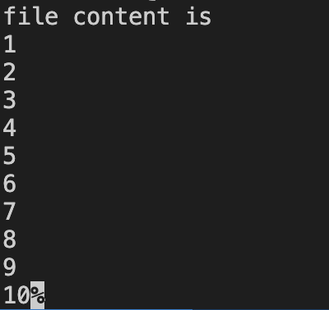
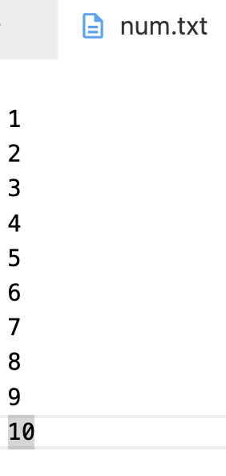
Note: putw() function is used to write single integer to the file named “num.txt” from memory
Memory
User screen
File name “num.txt” (Notepad)
i
1 2 3 . . 10
putw()
printf()
getw()
Note: printf() function is used to display data from Memory
Note: getw() function is used to store /input single integer to memory from datafile “num.txt”

Slide 81
3) Write a C program using fprintf() and fscanf() to store and read employee details such as ID, Name, and Salary in a file named emp.txt, and then display the stored information on the screen.
fp = fopen("emp.txt", "r"); //open for reading
if (fp == NULL) {
printf("Error opening file for writing.\n");
return 0;
}
fscanf(fp, "%d %s %f", &id, name, &salary);
printf("Id: \t Name \t Salary \n");
printf("%d \t %s \t %f ", id, name, salary);
fclose(fp);
return 0;
}
#include <stdio.h>
int main()
{
FILE *fp;
int id;
char name[30];
float salary;
fp = fopen("emp.txt", "w"); //open for writing
if (fp == NULL) {
printf("Error opening file for writing.\n");
return 0;
}
printf("Enter the id, Name and Salary \n");
scanf("%d %s %f", &id, name, &salary);
fprintf(fp, "%d %s %f", id, name, salary);
fclose(fp);

Slide 82
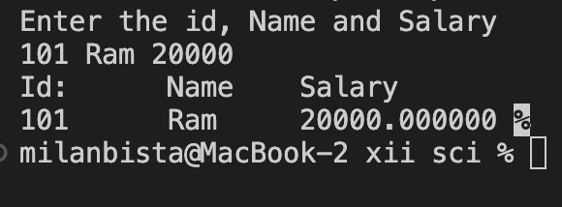
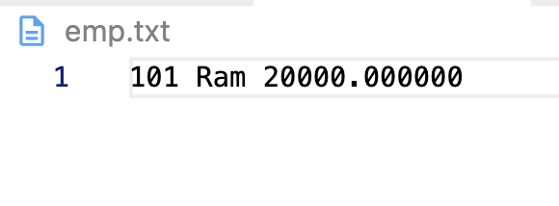
Note: scanf() function is used to store/input data to memory from userscreen.
Note: fprintf() function is used to write data to the file named “emp.txt.txt” from memory.
User screen
File name “emp.txt” (Notepad)
Memory
scanf()
int id | 101
char name[30] | 0 | 1 | 2 | ---29
 | R | a | m
Salary | 2000.00000
fprintf()
printf()
fscanf()
Note: fscanf() function is used to store /input data to memory from datafile “emp.txt”
Note: printf() function is used to display/output information from Memory

Slide 83
4) Write a C program using structure and file handling to store student details (serial number, name, and age) in a binary file using fwrite() and then read and display all the records using fread().
#include <stdio.h>
struct student {
int no, age;
char name[30];
};
int main() {
struct student s;
FILE *fp;
char ch = 'y';
fp = fopen("student1.txt", "w");
if (fp == NULL) {
printf("Error opening file for writing.\n");
return 0; }
while (ch == 'y' || ch == 'Y') {
printf("Serial number: ");
scanf("%d", &s.no);
printf("Student name: ");
scanf("%s", s.name);
printf("Student age: ");
scanf("%d", &s.age);
fwrite(&s, sizeof(s), 1, fp); // write structure to file
printf("Do you want to add more (y/n): ");
scanf(" %c", &ch); // space before %c to consume newline
}
fclose(fp);
// Open file for reading
fp = fopen("student1.txt", "r");
if (fp == NULL) {
printf("Error opening file for reading.\n");
return 0;
}
printf("\nSN\tName\tAge\n");
// Read data using fread
while (fread(&s, sizeof(s), 1, fp) == 1) {
printf("%d\t%s\t%d\n", s.no, s.name, s.age);
}
fclose(fp);
return 0;
}

Slide 84
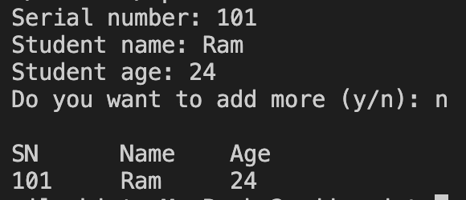
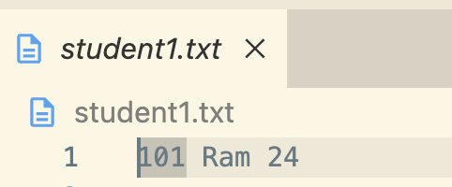
Note: scanf() function is used to store/input data to memory from userscreen.
Note: fwrite() function is used to write structure type data to the file named “student1.txt” from memory.
User screen
File name “student1.txt” (Notepad)
Memory
scanf()
int no | 101
char name[30] | 0 | 1 | 2 | ---29
 | R | a | m
age | 24
fwrite()
fread()
printf()
Note: fread() function is used to (store or input or to read) structure type data to memory from datafile “emp.txt”
Note: printf() function is used to display/output information from Memory

Slide 85
5) WAP to store book’s name, edition and price in a data file “book.txt” using user choice.
fclose(fp);
fp=fopen("book.txt","r");
printf("Book Name \t Edition \t Price\n");
while(fscanf(fp,"%s%d%f", name, &edition, &price)!=EOF)
{
printf("%s\t\t %d\t %.2f\n ", name, edition, price);
}
fclose(fp);
return 0;
}
#include<stdio.h>
int main()
{
char name[30];
int edition;
float price;
char ch='y';
FILE *fp;
fp=fopen("book.txt","w");
while(ch=='y')
{ printf("Enter book name : " );
scanf("%s", name);
printf("Enter book edition : " );
scanf("%d", &edition);
printf("Enter book price : " );
scanf("%f", &price);
fprintf(fp,"%s\t %d\t %f\n", name, edition, price);
printf("Add more records (y/n) : ");
scanf(" %c",&ch);
}

Slide 86
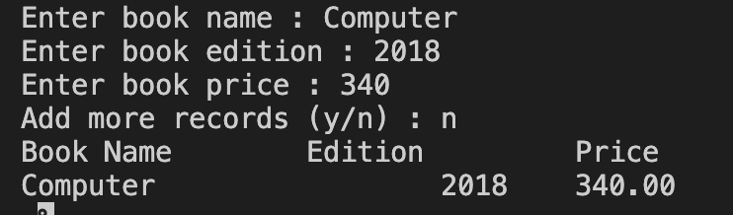
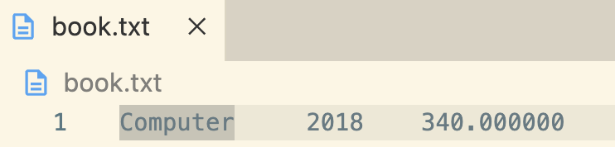
Note: scanf() function is used to store/input data to memory from userscreen.
Note: fprintf() function is used to write data to the file named “emp.txt.txt” from memory.
User screen
File name “emp.txt” (Notepad)
Memory
scanf()
edition | 2018
char name[30] | 0 | 1 | 2 | ---29
 | c | o | m | p | u | t | e | r
price | 340
fprintf()
fscanf()
printf()
Note: fscanf() function is used to store /input data to memory from datafile “emp.txt”
Note: printf() function is used to display/output information from Memory

Slide 87


6) Write C program to show the concept of rename() and remove functions.
At First,
#include<stdio.h>
int main()
{
FILE *fp;
char name[30];
fp=fopen(”alpha.txt","w");
fclose(fp);
}
file name : alpha.txt
At Second,
#include<stdio.h>
int main()
{
FILE *fp;
char name[30];
fp=fopen("alpha.txt","w");
rename("alpha.txt","beta.txt");
fclose(fp);
}
file name : beta.txt
At Last,
#include<stdio.h>
int main()
{
FILE *fp;
char name[30];
fp=fopen("alpha.txt","w");
rename("alpha.txt","beta.txt");
remove("beta.txt");
fclose(fp);
}
No File
// Afer remove() function
There is no file present.

Slide 88


7) Write C program to show concept of ftell(), and rewind() functions.
#include<stdio.h>
int main ()
{
char name [30];
int age, length;
FILE *fp;
fp = fopen ("arunima.txt","w");
printf("Enter your name: \n");
scanf("%s",name);
printf("Enter your age: \n");
scanf("%d",&age);
fprintf (fp, "%s %d", name, age); length = ftell(fp);
rewind (fp);
fscanf (fp, "%s", name);
fscanf (fp, "%d", &age);
fclose (fp);
printf ("Name= %s \n Age= %d \n",name,age);
printf ("Total number of characters in file is %d \n", length);
return 0;}
scanf
Memory
printf
name | 0 | 1 | 2 | 3 | …29
 | r | a | m
age | 24
length
fprintf
rewind
fscanf
ftell() - It tells the byte location of current position in file pointer.
rewind() - It moves the control to beginning of a file.

Slide 89
Revision for second term 2082
Long question from structure [8 marks]
Write a C Program using structure variable to store n students records like rollNo, name and address using array and loop.
Program to store n students records like name, address and age using array and loop. Print the record on the basis of age between 20 and 30.
Long question from File Handling [8 marks]
Write a C program using fprintf() and fscanf() to store and read employee details such as ID, Name, and Salary in a file named emp.txt, and then display the stored information on the screen.
WAP to store book’s name, edition and price in a data file “book.txt” using user choice.
Long question from Recursive function [8 marks]
1.Write C program to print factorial of a number using recursive function.
2.Write C program to print fibonacci series upto nth term of a number using recursive function.
Short Question
Define Structure.
Define Recursive function
Define File Handling
Define Function

